Slide 1


Slide 2
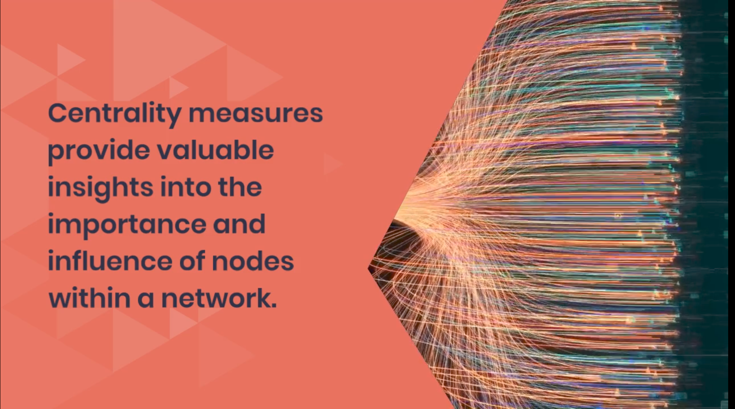

Slide 3


Slide 4


Slide 5
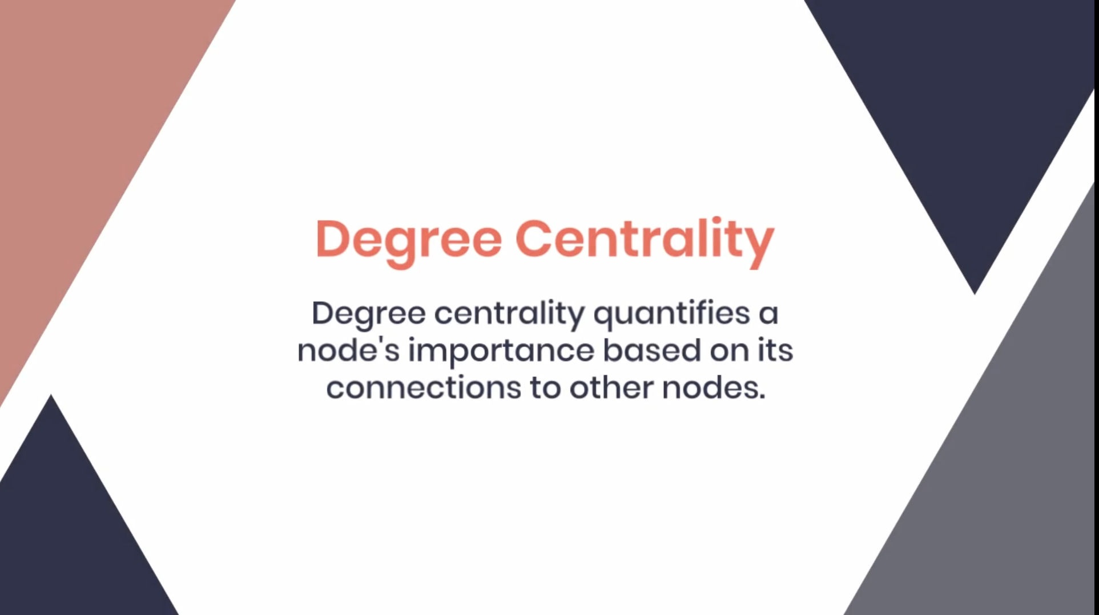

Slide 6


Slide 7
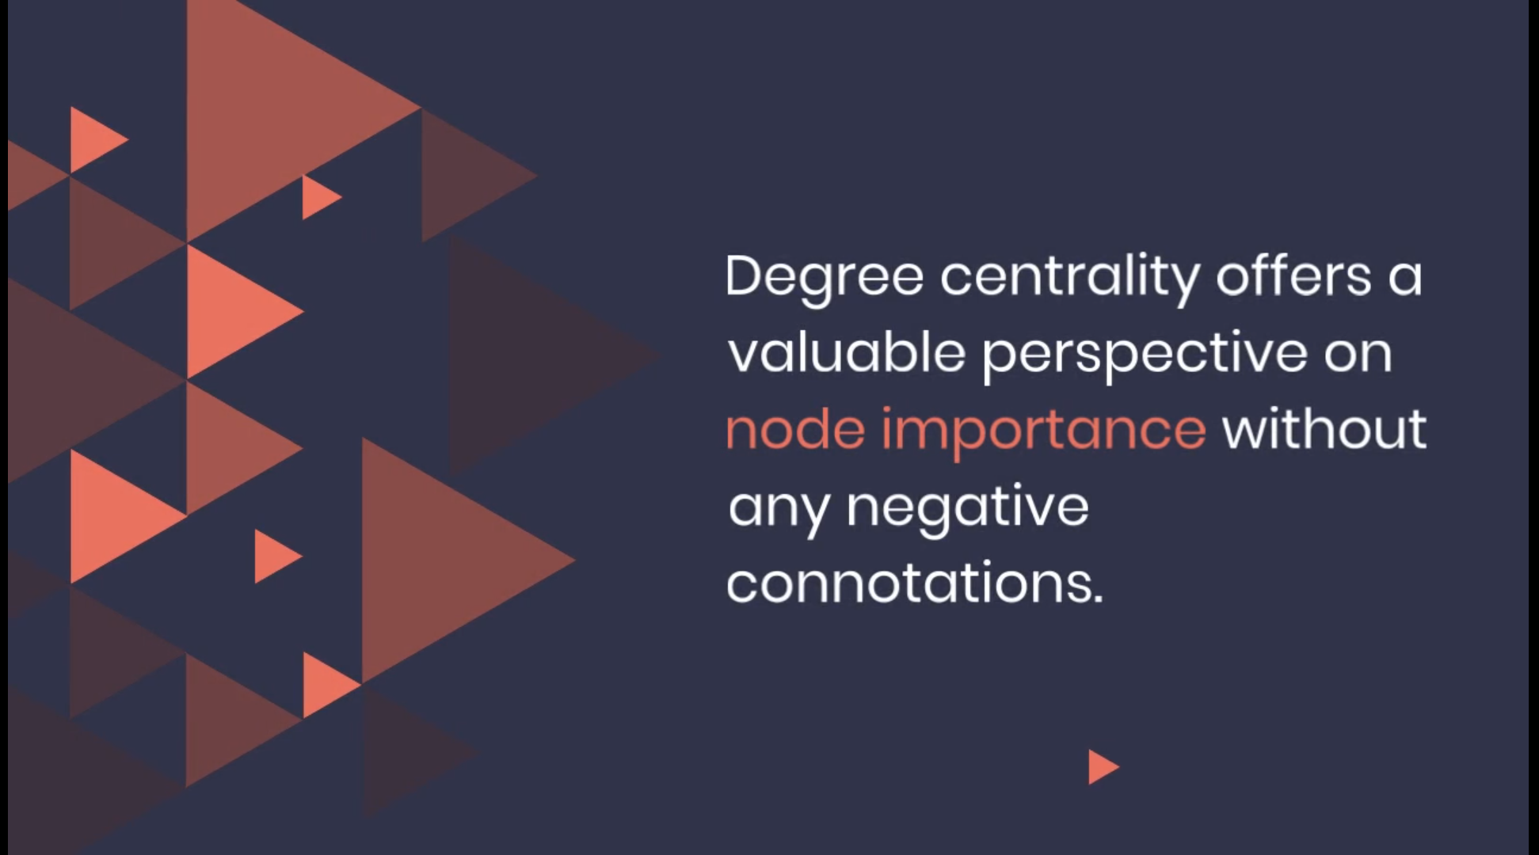

Slide 8
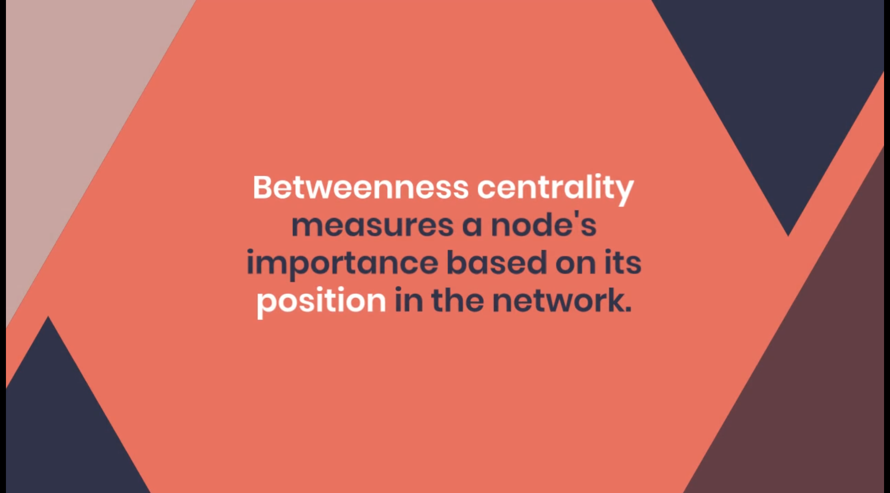

Slide 9
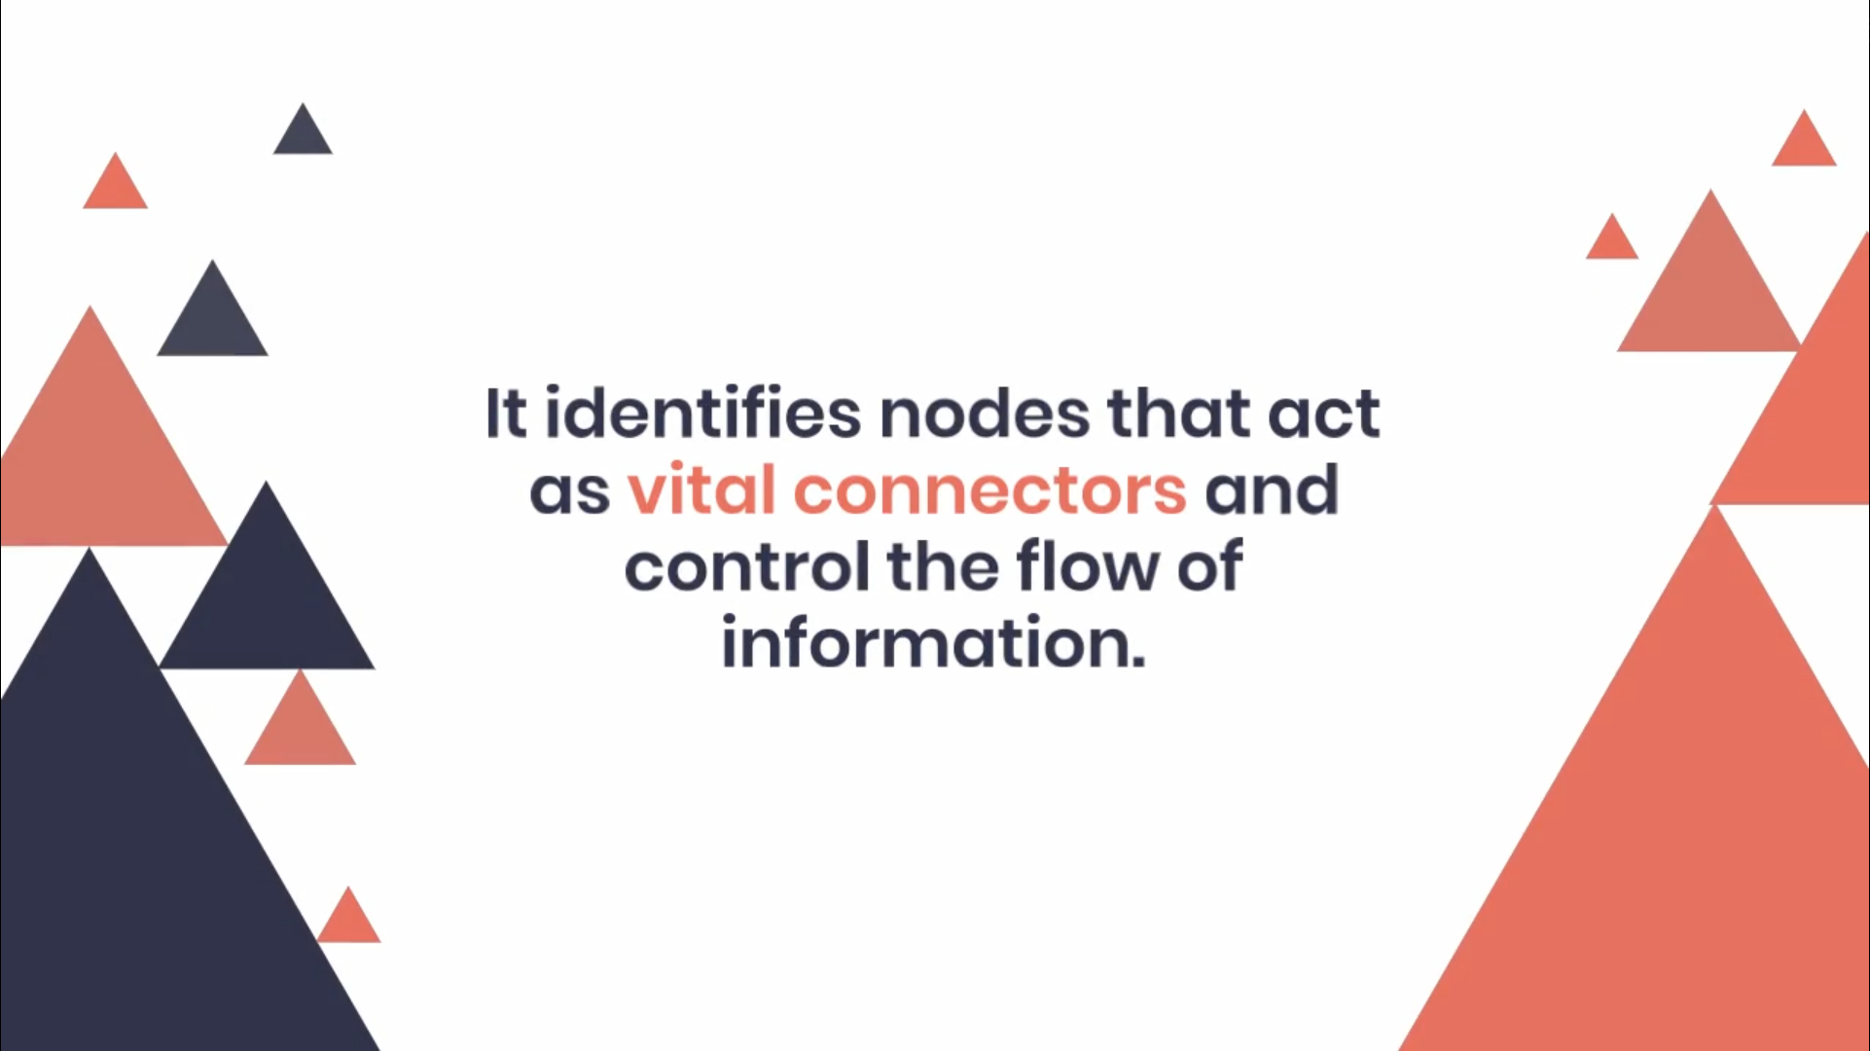

Slide 10
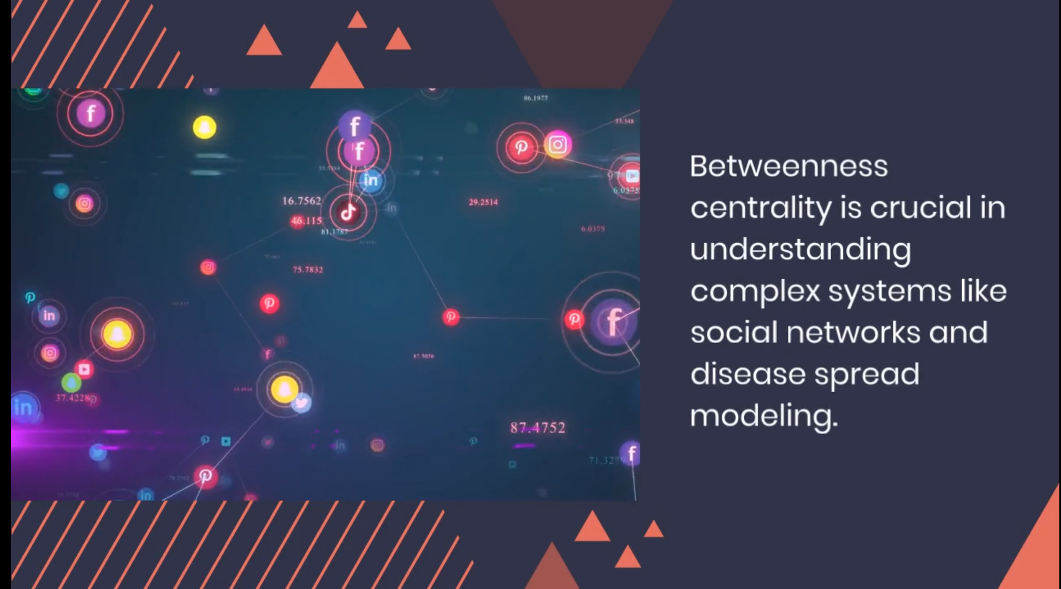

Slide 11
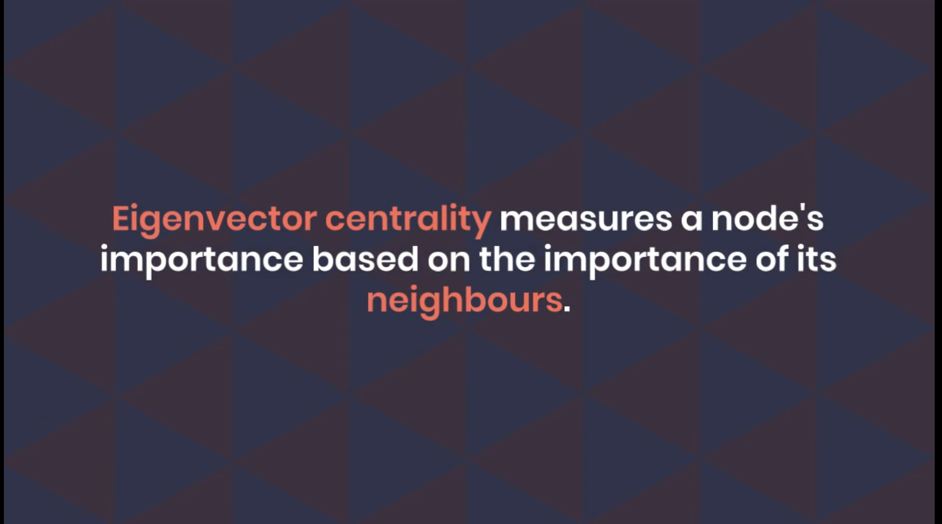

Slide 12
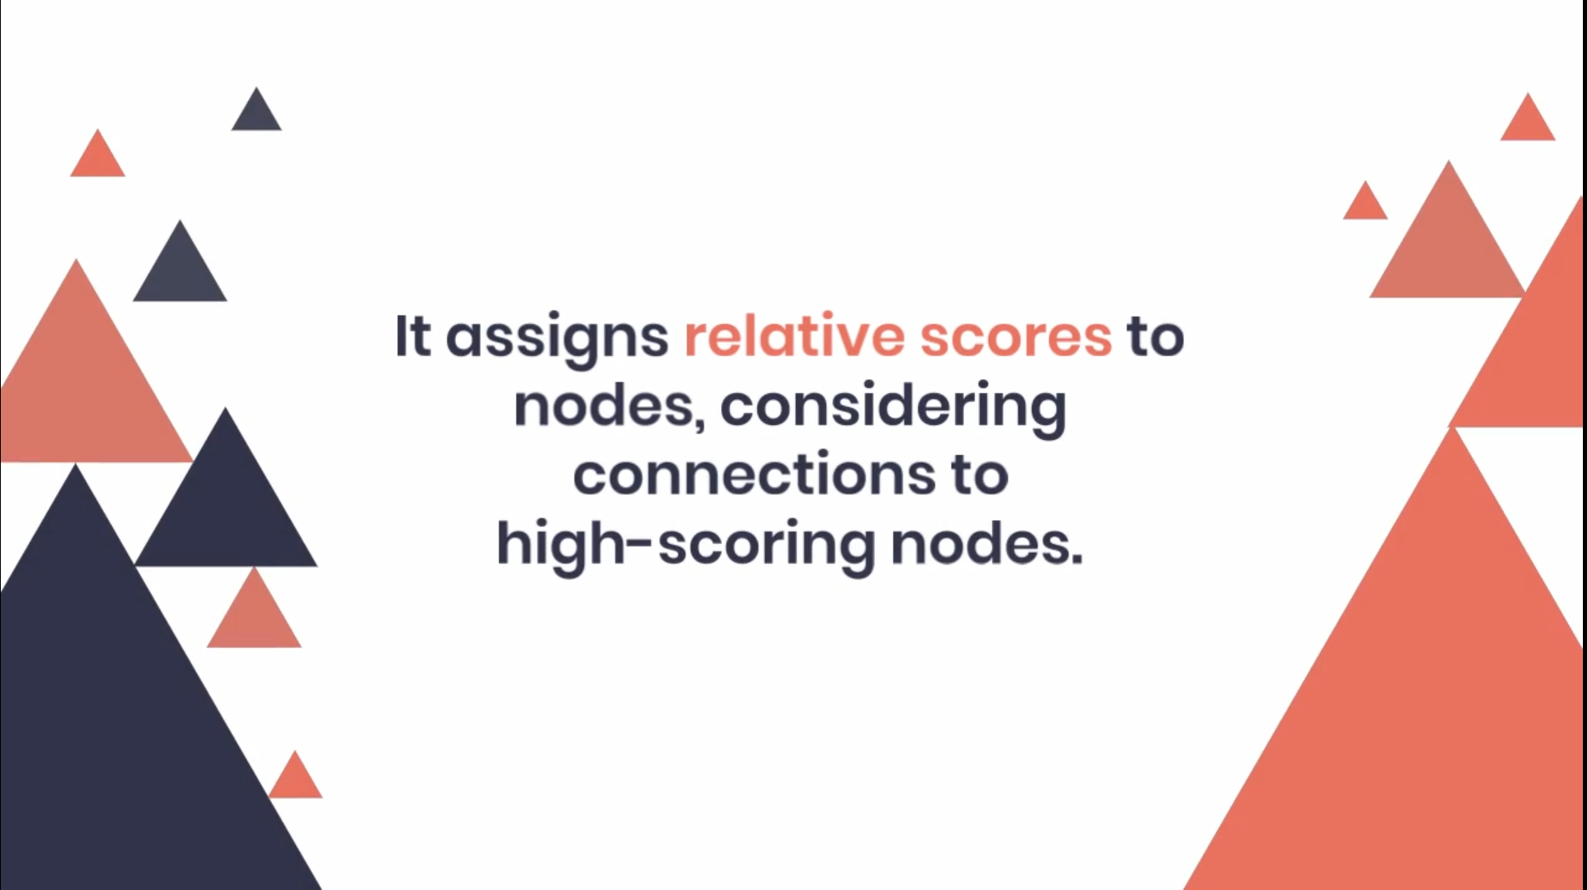

Slide 13


Slide 14
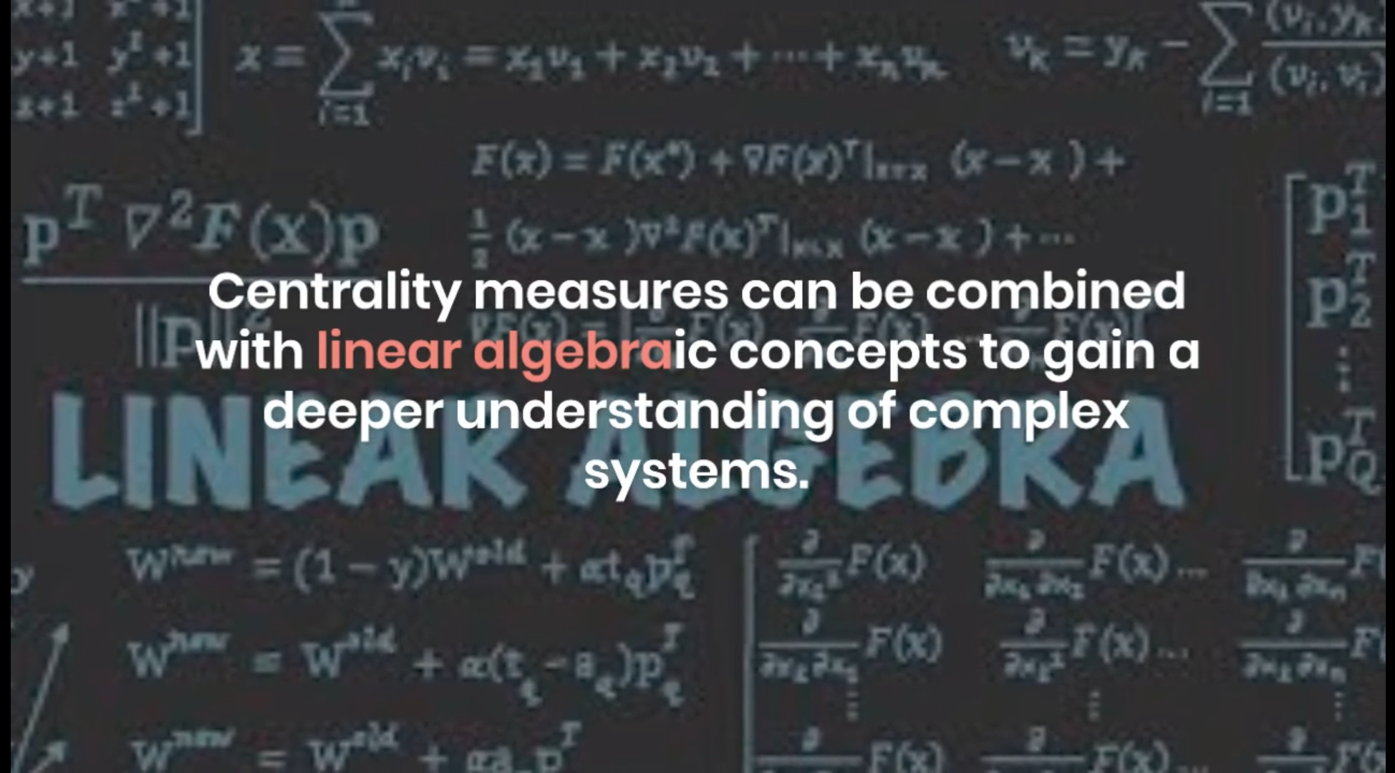

Slide 15
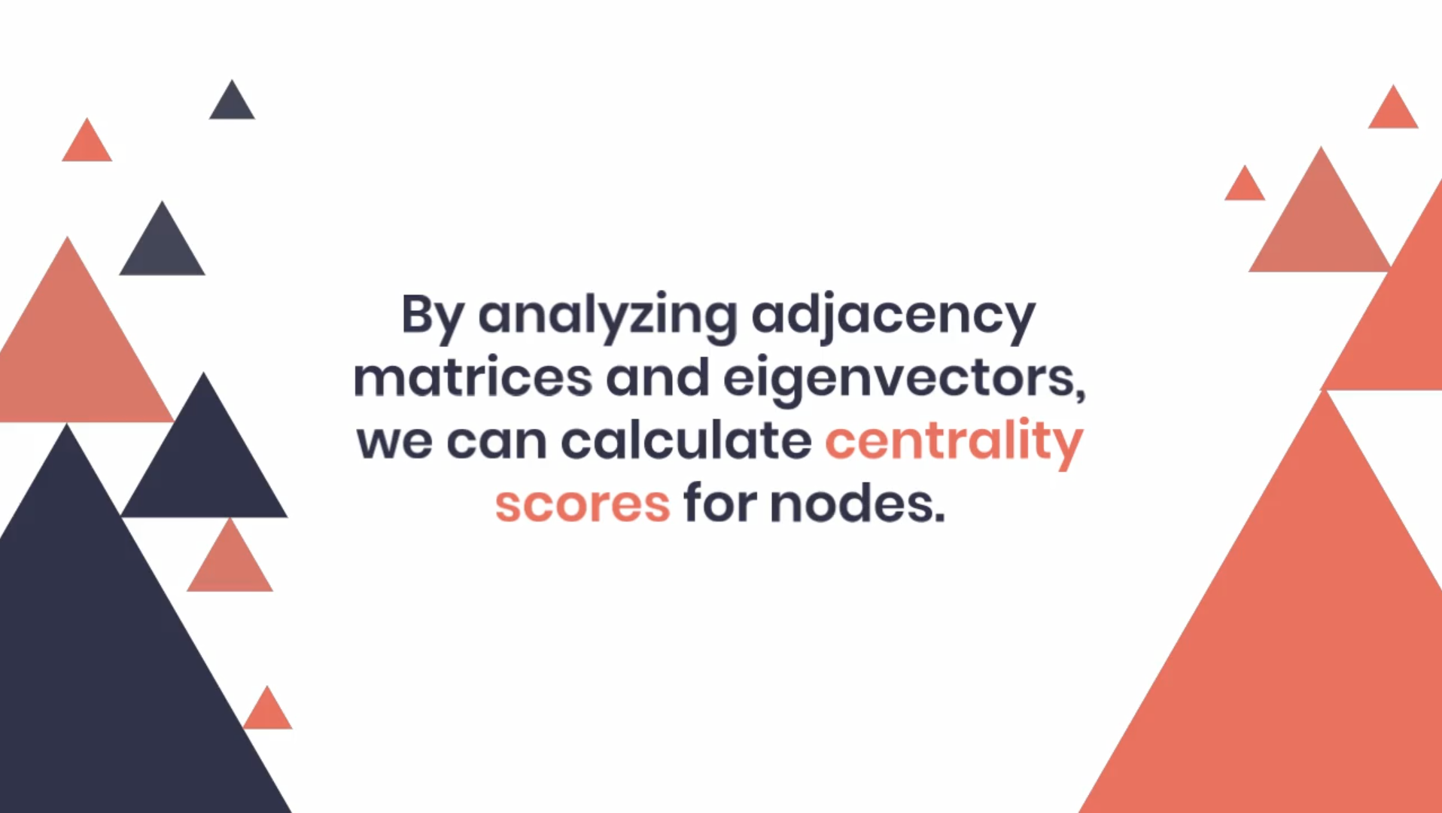

Slide 16
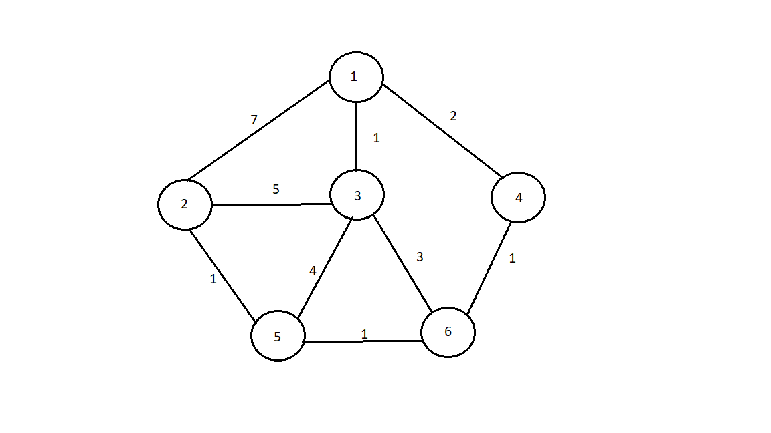
Example for Betweenness Centrality

Slide 17
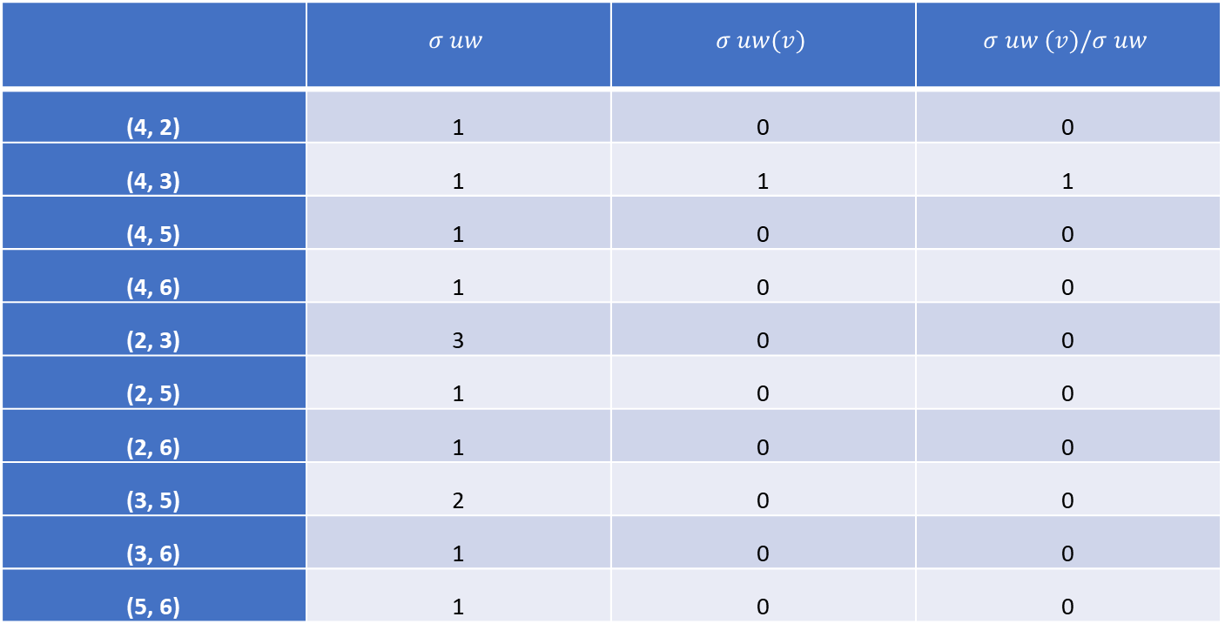
For node 1:
 | $$σ uw$$ | $$σ uw(v)$$ | $$σ uw (v)/σ uw$$
(4, 2) | 1 | 0 | 0
(4, 3) | 1 | 1 | 1
(4, 5) | 1 | 0 | 0
(4, 6) | 1 | 0 | 0
(2, 3) | 3 | 0 | 0
(2, 5) | 1 | 0 | 0
(2, 6) | 1 | 0 | 0
(3, 5) | 2 | 0 | 0
(3, 6) | 1 | 0 | 0
(5, 6) | 1 | 0 | 0
Hence, betweenness centrality of 1 is: 1

Slide 18

For node 2:
 | $$σ uw$$ | $$σ uw(v)$$ | $$σ uw (v)/σ uw$$
(1, 4) | 1 | 0 | 0
(1, 3) | 1 | 0 | 0
(1, 5) | 1 | 0 | 0
(1, 6) | 1 | 0 | 0
(4, 3) | 1 | 0 | 0
(4, 5) | 1 | 0 | 0
(4, 6) | 1 | 0 | 0
(3, 5) | 2 | 0 | 0
(3, 6) | 1 | 0 | 0
(5, 6) | 1 | 0 | 0
Hence, betweenness centrality of 2 is: 0

Slide 19
For node 3:
 | $$σ uw$$ | $$σ uw(v)$$ | $$σ uw (v)/σ uw$$
(1, 4) | 1 | 0 | 0
(1, 3) | 1 | 0 | 0
(1, 5) | 1 | 0 | 0
(1, 6) | 1 | 0 | 0
(4, 3) | 1 | 0 | 0
(4, 5) | 1 | 0 | 0
(4, 6) | 1 | 0 | 0
(3, 5) | 2 | 0 | 0
(3, 6) | 1 | 0 | 0
(5, 6) | 1 | 0 | 0
Hence, betweenness centrality of 3 is: 0

Slide 20

For node 4:
 | $$σ uw$$ | $$σ uw(v)$$ | $$σ uw (v)/σ uw$$
(1, 2) | 1 | 1 | 1
(1, 3) | 1 | 0 | 0
(1, 5) | 1 | 1 | 1
(1, 6) | 1 | 1 | 1
(2, 3) | 3 | 0 | 0
(2, 5) | 1 | 0 | 0
(2, 6) | 1 | 0 | 0
(3, 5) | 2 | 0 | 0
(3, 6) | 1 | 0 | 0
(5, 6) | 1 | 0 | 0
Hence, betweenness centrality of 4 is: 3

Slide 21

For node 5:
 | $$σ uw$$ | $$σ uw(v)$$ | $$σ uw (v)/σ uw$$
(1, 2) | 1 | 1 | 1
(1, 3) | 1 | 0 | 0
(1, 4) | 1 | 0 | 0
(1, 6) | 1 | 0 | 0
(2, 3) | 3 | 2 | 2/3
(2, 4) | 1 | 1 | 1
(2, 6) | 1 | 1 | 1
(3, 4) | 1 | 0 | 0
(3, 6) | 1 | 0 | 0
(4, 6) | 1 | 0 | 0
Hence, betweenness centrality of 5 is: 3.67

Slide 22

For node 6:
 | $$σ uw$$ | $$σ uw(v)$$ | $$σ uw (v)/σ uw$$
(1, 2) | 1 | 1 | 1
(1, 3) | 1 | 0 | 0
(1, 5) | 1 | 1 | 1
(1, 4) | 1 | 0 | 0
(2, 3) | 3 | 1 | 1/3
(2, 5) | 1 | 0 | 0
(2, 4) | 1 | 1 | 1
(3, 5) | 2 | 1 | 1/2
(3, 4) | 1 | 0 | 0
(5, 4) | 1 | 1 | 1
Hence, betweenness centrality of 6 is: 4.83

Slide 23
Maximum possible betweenness centrality for an undirected graph (M) is: (N-1)(N-2)/2 = (6-1)(6-2)/2 = 10
Vertex | Betweenness Centrality | Normalized BC ( = BC/M )
1 | 1 | 0.1
2 | 0 | 0
3 | 0 | 0
4 | 3 | 0.3
5 | 3.67 | 0.367
6 | 4.83 | 0.483

Slide 24
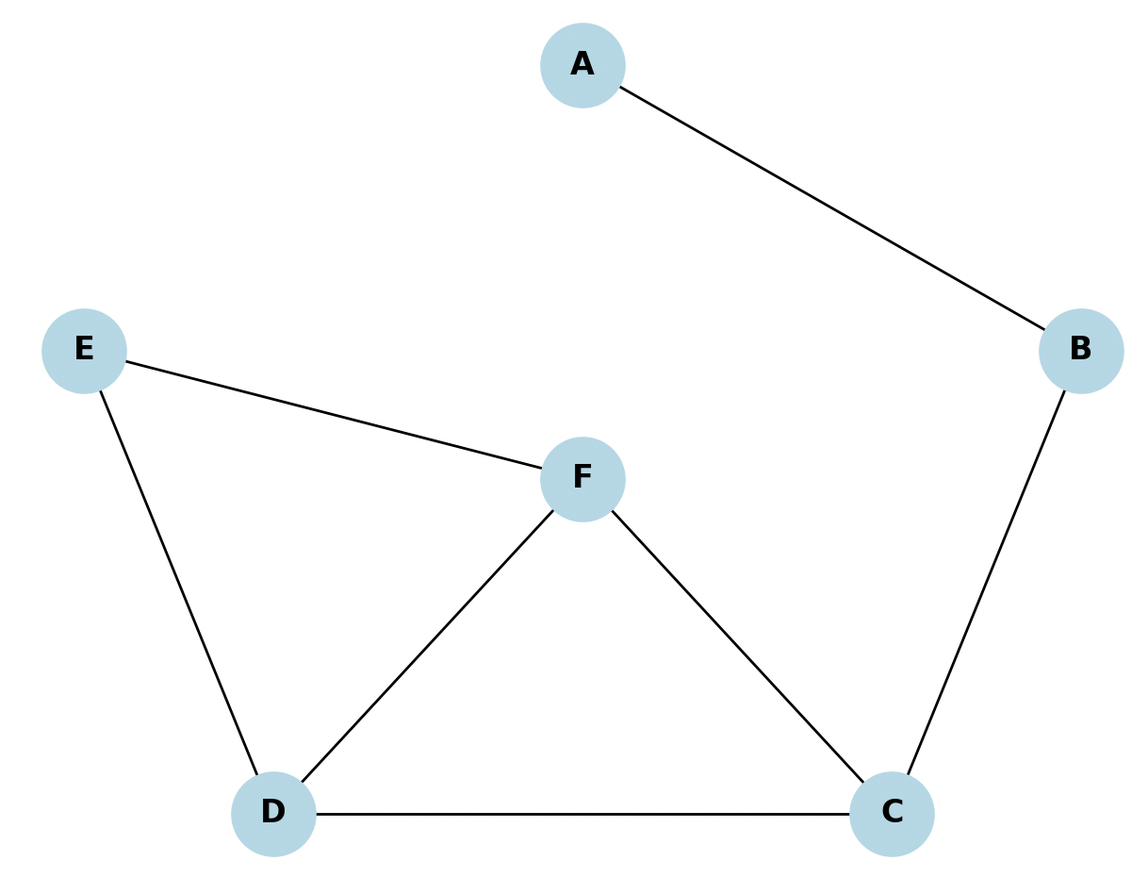
Example for Eigen Vector Centrality

Slide 25
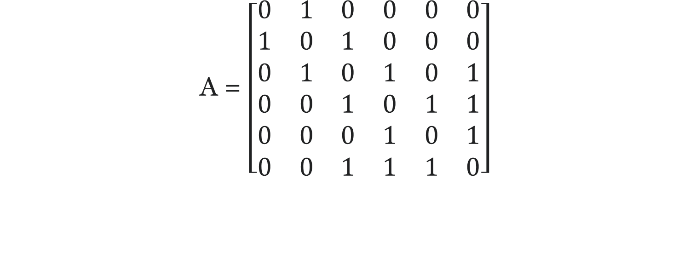
The adjacency matrix is:
A = $\left[\begin{matrix}0 & 1 & 0 & 0 & 0 & 0 \\ 1 & 0 & 1 & 0 & 0 & 0 \\ 0 & 1 & 0 & 1 & 0 & 1 \\ 0 & 0 & 1 & 0 & 1 & 1 \\ 0 & 0 & 0 & 1 & 0 & 1 \\ 0 & 0 & 1 & 1 & 1 & 0\end{matrix}\right]$

Slide 26
Node | Degree
A | 1
B | 2
C | 3
D | 3
E | 2
F | 3

Slide 27
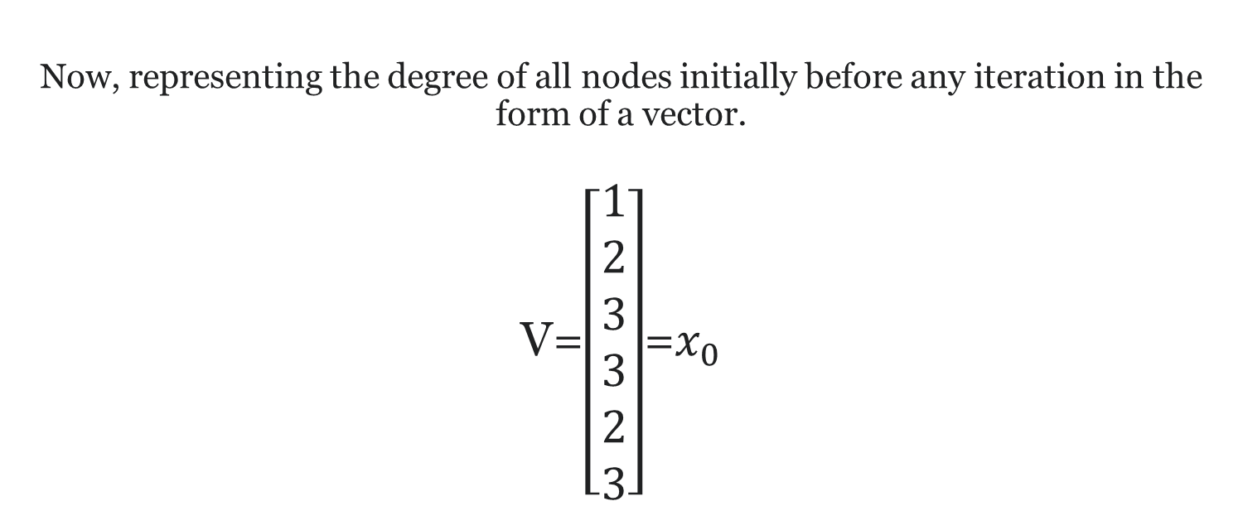
Now, representing the degree of all nodes initially before any iteration in the form of a vector. V=$\left[\begin{aligned}1 \\ 2 \\ 3 \\ 3 \\ 2 \\ 3\end{aligned}\right]$=$x_{0}$

Slide 28
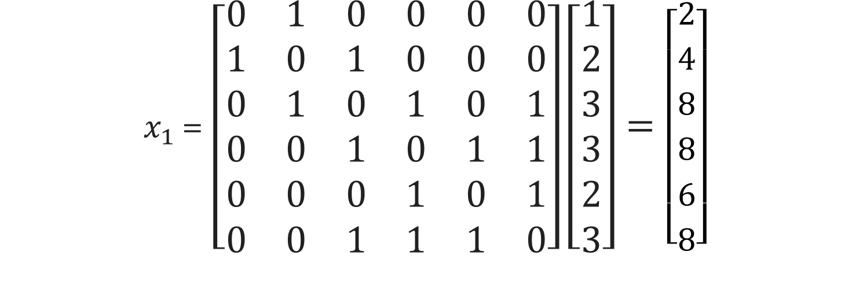
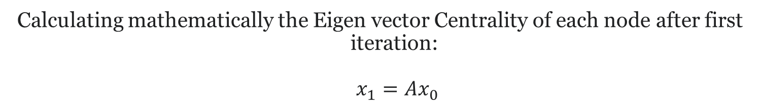
Calculating mathematically the Eigen vector Centrality of each node after first iteration: $x_{1}=Ax_{0}$
$x_{1 }$= $\left[\begin{matrix}0 & 1 & 0 & 0 & 0 & 0 \\ 1 & 0 & 1 & 0 & 0 & 0 \\ 0 & 1 & 0 & 1 & 0 & 1 \\ 0 & 0 & 1 & 0 & 1 & 1 \\ 0 & 0 & 0 & 1 & 0 & 1 \\ 0 & 0 & 1 & 1 & 1 & 0\end{matrix}\right]\left[\begin{aligned}1 \\ 2 \\ 3 \\ 3 \\ 2 \\ 3\end{aligned}\right]=\left[\begin{aligned}2 \\ 4 \\ 8 \\ 8 \\ 6 \\ 8\end{aligned}\right]$

Slide 29
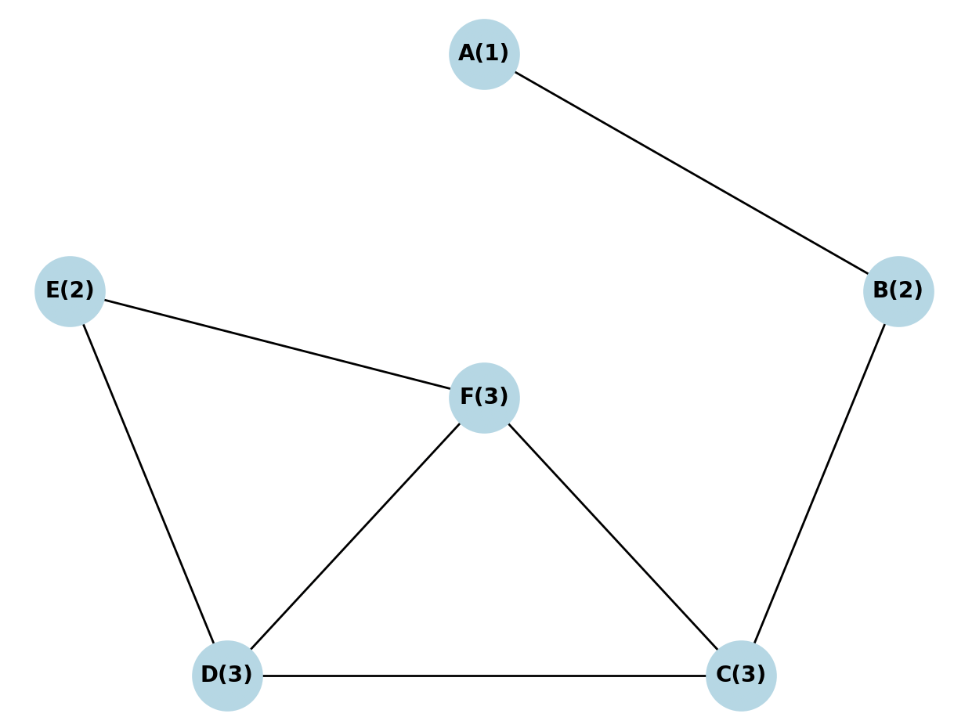
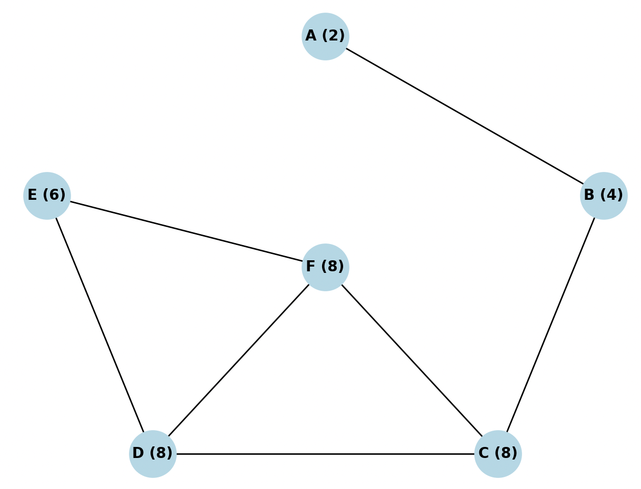

Slide 30
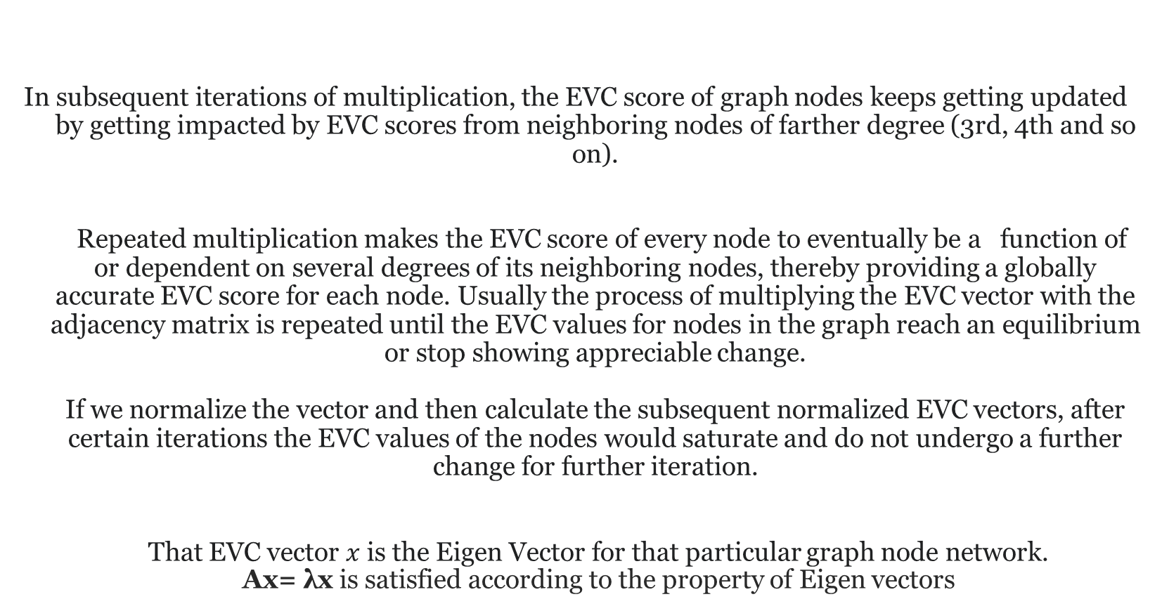
In subsequent iterations of multiplication, the EVC score of graph nodes keeps getting updated by getting impacted by EVC scores from neighboring nodes of farther degree (3rd, 4th and so on). Repeated multiplication makes the EVC score of every node to eventually be a function of or dependent on several degrees of its neighboring nodes, thereby providing a globally accurate EVC score for each node. Usually the process of multiplying the EVC vector with the adjacency matrix is repeated until the EVC values for nodes in the graph reach an equilibrium or stop showing appreciable change. If we normalize the vector and then calculate the subsequent normalized EVC vectors, after certain iterations the EVC values of the nodes would saturate and do not undergo a further change for further iteration. That EVC vector $x$ is the Eigen Vector for that particular graph node network. Ax= λx is satisfied according to the property of Eigen vectors

